Slide 1

Go, change the world
RV College of
Engineering
Parallel Architecture and Distributed Programming
Department of CSE
Self Study
Pratheeksha P
1RV17CS112

Slide 2

Go, change the world
RV College of
Engineering
Hybrid Programming with MPI and OpenMP

Slide 3
Go, change the world
Introduction
RV College of
Engineering
Hybrid programming is an attempt to utilize the best features of both MPI and OpenMP. It may not always be beneficial, since it depends heavily on the problem statement and computational and communication loads. The basic concept is to use MPI across the nodes and OpenMP within the node. Hybrid application programs using MPI + OpenMP are now commonly used in large HPC systems.
Motivation:
Reduction in memory footprint
Improved performance
Balance the computational load

Slide 4
Go, change the world
RV College of
Engineering
OpenMP only
launch one process per node
have each process fork one thread (or more) per core
share data using shared memory
can’t share data with a different process (except maybe via file I/O)
MPI only
launch one process per core,on one node or on many
pass messages among processes irrespective of the location
create different communicators intra-node vs. inter-node
ignore the potential for any memory to be shared
With hybrid OpenMP/MPI programming, each MPI process will launch multiple OpenMP threads that can share local memory.

Slide 5
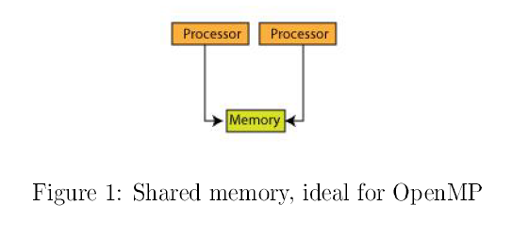
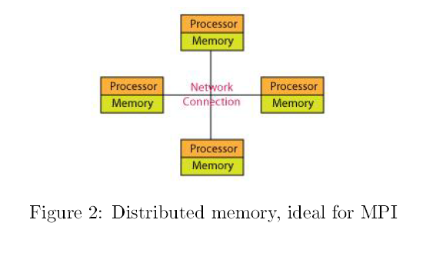
Go, change the world
RV College of
Engineering

Slide 6
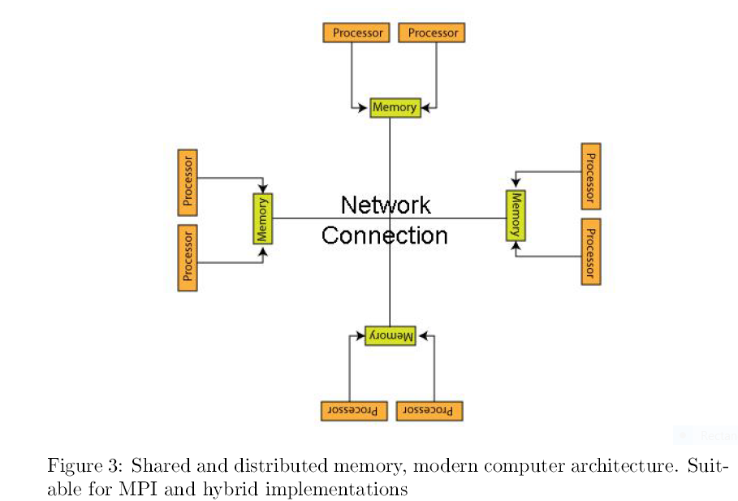
Go, change the world
RV College of
Engineering

Slide 7
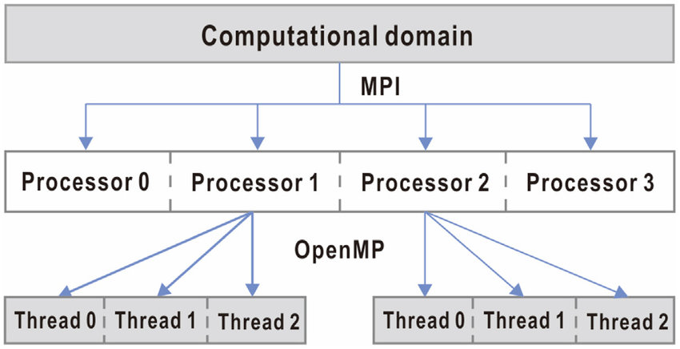
Go, change the world
RV College of
Engineering

Slide 8
Go, change the world
RV College of
Engineering
MPI Support for threads
In general making libraries thread-safe is difficult.
Internal data structures in the library either have to be replicated (for example, one per thread), or accesses to these structures must be protected by some form of synchronisation (typically locks).
The MPI specification defines the following four classes of thread safety:
MPI_THREAD_SINGLE – Only one thread will execute.
MPI_THREAD_FUNNELED – The process may be multi-threaded, but only the main thread will make MPI calls (all MPI calls are funneled to the main thread).
MPI_THREAD_SERIALIZED – The process may be multi-threaded, and multiple threads may make MPI calls, but only one at a time.
MPI_THREAD_MULTIPLE – Multiple threads may call MPI, with no restrictions.

Slide 9
Go, change the world
MPI+OpenMP styles
RV College of
Engineering
5 distinct styles :
Master-only
Funneled
Serialized
Multiple
Asynchronous Tasks

Slide 10
Go, change the world
RV College of
Engineering
MASTER-ONLY
All MPI calls are made by the OpenMP master thread and outside of parallel regions.
This requires the MPI_THREAD_FUNNELED level of thread support, since other threads will be executing, but not calling MPI.
It is implemented by identifying the most time consuming loops and using parallel constructs to multithread them.
Threads other than the master are necessarily idle during MPI calls, and cannot do any useful computation.
#pragma omp parallel
{
work…
}
ierror=MPI_Send(…);
#pragma omp parallel
{
work…
}

Slide 11
Go, change the world
RV College of
Engineering
FUNNELED
In Funneled style, all MPI calls are made by the OpenMP master thread, but this may include calls from inside OpenMP parallel regions.
It is easy to synchronize threads.
It possible for other threads to do useful computation while the master thread is executing MPI calls.
#pragma omp parallel
{
… work
#pragma omp barrier
#pragma omp master
{
ierror=MPI_Send(…);
}
#pragma omp barrier
… work
}

Slide 12
Go, change the world
RV College of
Engineering
SERIALIZED
In Serialized style, any thread inside an OpenMP parallel region can make calls to the MPI library.
The threads must be synchronised in such a way that only one thread at a time may be in an MPI call.
This style requires MPI_THREAD_SERIALIZED support.
Tags or communicators are used to distinguish between messages from (or to) different threads in the same MPI process.
#pragma omp parallel
{
… work
#pragma omp critical
{
ierror=MPI_Send(…);
}
… work
}

Slide 13
Go, change the world
RV College of
Engineering
MULTIPLE
In Multiple style, any thread inside (or outside) a parallel region may call MPI, and there are no restrictions on how many threads may be executing MPI calls at the same time.
This requires MPI_THREAD_MULTIPLE support.
Synchronization is taken care of by the MPI library.
Compared to Master-Only or Funneled style, the internal synchronisation overheads are high which degrades the communication performance.
#pragma omp parallel
{
… work
ierror=MPI_Send(…);
… work
}
ierror=MPI_Send(…);

Slide 14
Go, change the world
RV College of
Engineering
ASYNCHRONOUS TASKS
In Asynchronous Tasks style, MPI calls occur inside OpenMP dependent tasks.
The idea of using OpenMP dependent tasks is to minimise the synchronisation between threads and allow the OpenMP runtime as much flexibility as possible in scheduling computation and communication.
Since multiple threads may make concurrent MPI calls, this is a special case of Multiple style and requires MPI_THREAD_MULTIPLE support.
#pragma omp parallel
{
#pragma omp single
{
#pragma omp task depend (out:sbuf) { … write sbuf }
… more tasks
#pragma omp task depend (in:sbuf) depend (out:rbuf)
{ MPI_SendRecv(sbuf,…,rbuf,…); }
… more tasks
#pragma omp task depend (in:rbuf) { … use rbuf }
}// end single
}// end parallel

Slide 15
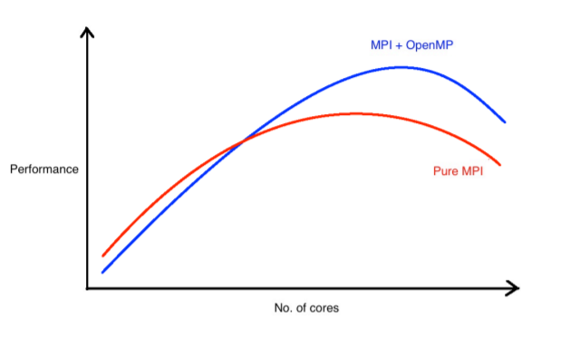
Go, change the world
Potential Advantages
RV College of
Engineering
Reducing memory requirements
Improving performance
Exploiting additional layers of parallelism
Reducing communication overheads
Reducing load imbalance
Reducing memory access costs

Slide 16
Go, change the world
Performance Pitfalls
RV College of
Engineering
Idle threads (Master only style)
Synchronisation - If the hybrid code calls MPI from more than one thread, then there will be additional synchronisation overheads to prevent race conditions inside the MPI library.
MPI derived datatypes - Derived datatypes allow the programmer to specify message data that is not contiguous in memory. The MPI library is then responsible for packing the data into a contiguous internal buffer before sending the message and unpacking the data from another contiguous internal buffer into user memory. This packing and unpacking can be quite expensive: the copying consumes CPU, cache and memory bandwidth resources.

Slide 17
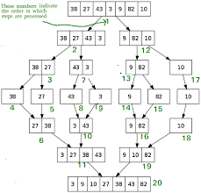
Go, change the world
MergeSort
RV College of
Engineering
MergeSort(arr[], l, r)
If r > l
1. Find the middle point to divide the array into two halves:
middle m = (l+r)/2
2. Call mergeSort for first half:
Call mergeSort(arr, l, m)
3. Call mergeSort for second half:
Call mergeSort(arr, m+1, r)
4. Merge the two halves sorted in step 2 and 3:
Call merge(arr, l, m, r)

Slide 18
Go, change the world
RV College of
Engineering
MergeSort
Input Size vs Execution Time
INPUT SIZE | SERIALIZED | OPENMP (2 Threads) | MPI | HYBRID (2 Threads per proc)
100000 | 0.02 | 0.01 | 0.02 | 0.02
1000000 | 0.15 | 0.08 | 0.14 | 0.08
10000000 | 1.64 | 0.90 | 1.56 | 0.82
100000000 | 49.17 | 28.89 | 48.18 | 16.61

Slide 19
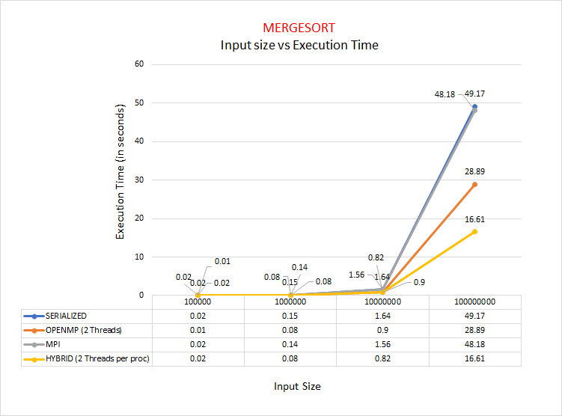

Slide 20
Go, change the world
RV College of
Engineering
References
Kushal Kedia,Hybrid Programming with OpenMP and MPI, MIT press, 2019
Rolf Rabenseifner, Georg Hager,Gabriele Jost, Hybrid MPI and OpenMP Parallel Programming, https://www.openmp.org//wp-content/uploads/HybridPP_Slides.pdf
https://www.cac.cornell.edu/education/Training/Intro/Hybrid-090529.pdf
https://docs.rc.fas.harvard.edu/kb/hybrid-mpiopenmp-codes-on-odyssey/

Slide 21
Go, change the world
RV College of
Engineering
THANK YOU

